Slide 1
Automatic Social Interaction Analysis System based on a Wearable device for People with Depression
Applications of Deep Learning Models
for Time Series Analysis
Presented by:
Ossama Alshabrawy
PhD Student, ICOS group
School of Computing, Newcastle University

Slide 2

Outline
Aims & Objectives
Recap for Deep learning (DL) models for time series data
Application 1: Speech Detection
Application 2: Wearer Detection
Application 3: Movement Pattern Analysis
Conclusion

Slide 3
Problem Statement

Slide 4

Aims & Objectives
Monitoring and assessing the different aspects of Social interaction in naturalistic setting environments using a wearable device.
There is a close connection between behaviour and wider social interactions

Slide 5
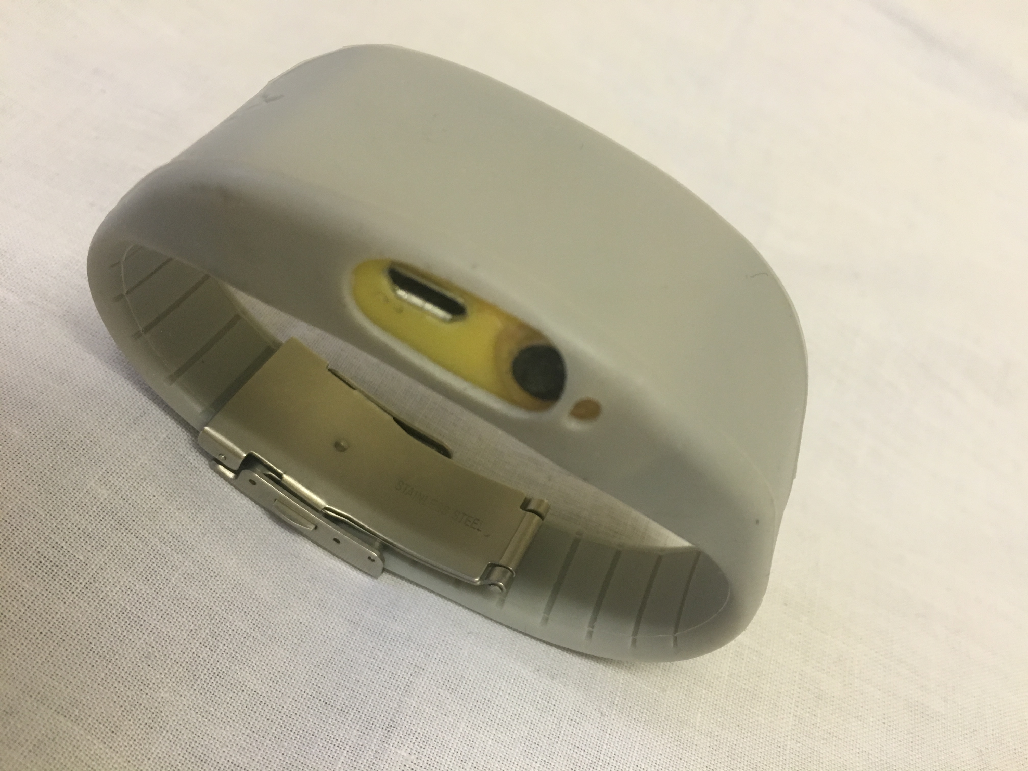
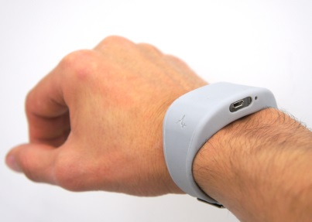
Study device
WAM is a stand-alone, wrist-mounted device…
Microphone (8KHz)
Tri-axial Accelerometer (50Hz)
Internal storage
Lithium ion battery
duration of seven days
https://github.com/digitalinteraction/openmovement
Notes:
WM … that recorded physical activity via three accelerometers and audio via a microphone.
It has no buttons or UI so, There is no fear that the user could accidentally press a button and the device stop recording or losing valuable data,
the device is ready as soon as it is put on.

Slide 6
Recurrent Neural Networks

Slide 7
Recurrent Neural Networks
Vanishing gradient problem

Slide 8
Bi-Directional Recurrent Neural Networks

Slide 9
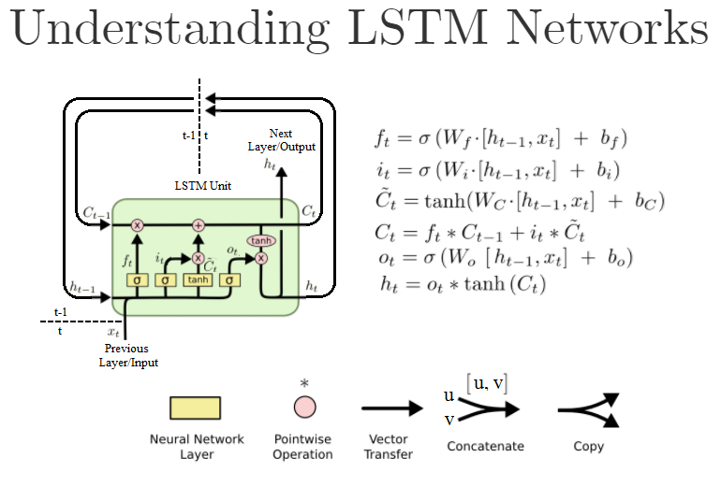
Long Short-Term Memory (LSTM)

Slide 10
Long Short-Term Memory (LSTM)
﻿The input, forget, and output gates are displayed below, left and above the hidden layer respectively.
Gates are either entirely open (‘O’) or closed (‘—’).
The memory cell ‘remembers’ the first input as long as the forget gate is open and the input gate is closed.

Slide 11
Looking Beyond LSTMs
CNN as alternative to time series modelling
Google Wavenet: Speech synthesis model
https://deepmind.com/blog/wavenet-generative-model-raw-audio/

Slide 12
Application 1: Speech Detection in Naturalistic Environments
Also called voice activity detection (VAD)
VAD: Determine whether speech is present in a particular audio signal
Issues: loud noise classified as speech and soft speech classified as noise

Slide 13
Application 1: Speech Detection in Naturalistic Environments
Datasets:
Depression Dataset (sensitive data): 7 days per participant, unannotated
30 healthy control subjects
30 depressed patients
Both audio and accelerometer
Discussion Dataset: (will be used for training and validation)
15 sessions of non-sensitive discussions (annotated)
Audio only
Public Datasets:
Aurora 2(annotated)
Aurora 4(annotated)
TIMIT(annotated)
Audio only

Slide 14
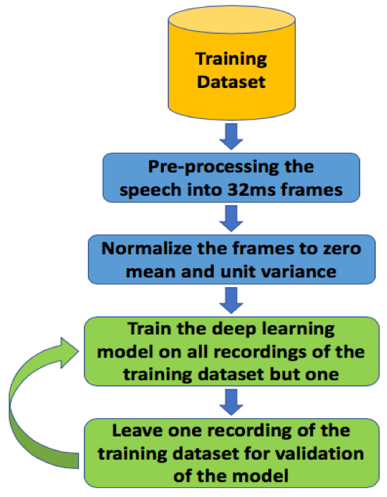
Application: Speech Detection in Naturalistic Environments
Validation Process for datasets in which annotations is available
Leave One Session Out Cross Validation

Slide 15
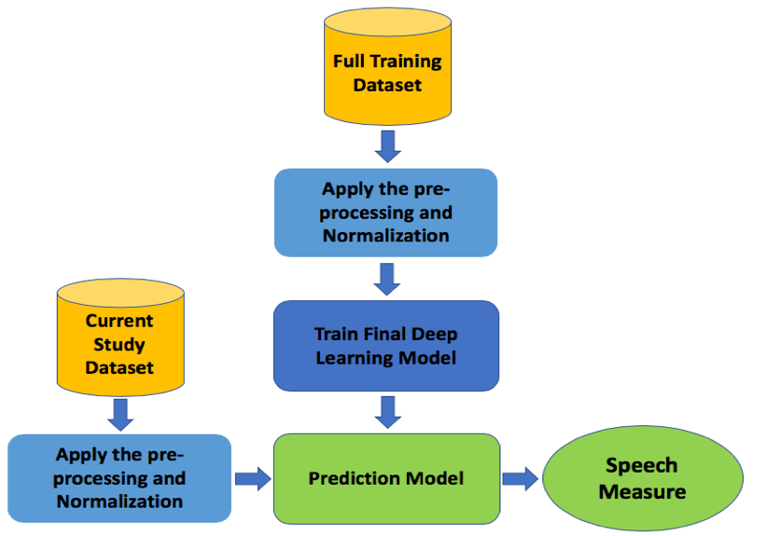
Application: Speech Detection in Naturalistic Environments
Application of our trained model on Depression Dataset

Slide 16
DL Frameworks
Tensorflow
Theano
Keras
Pytorch
Deeplearning4j (DL4j)

Slide 17
NatSpeech: Network Architecture

Slide 18
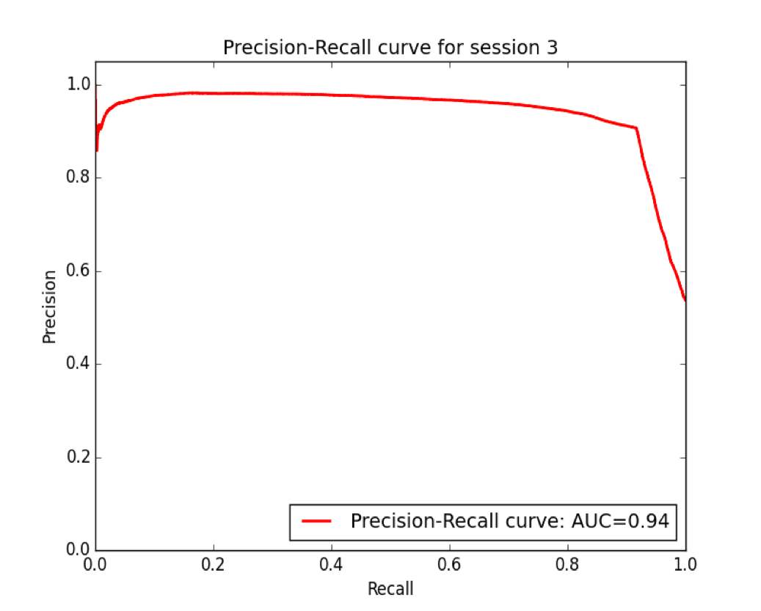
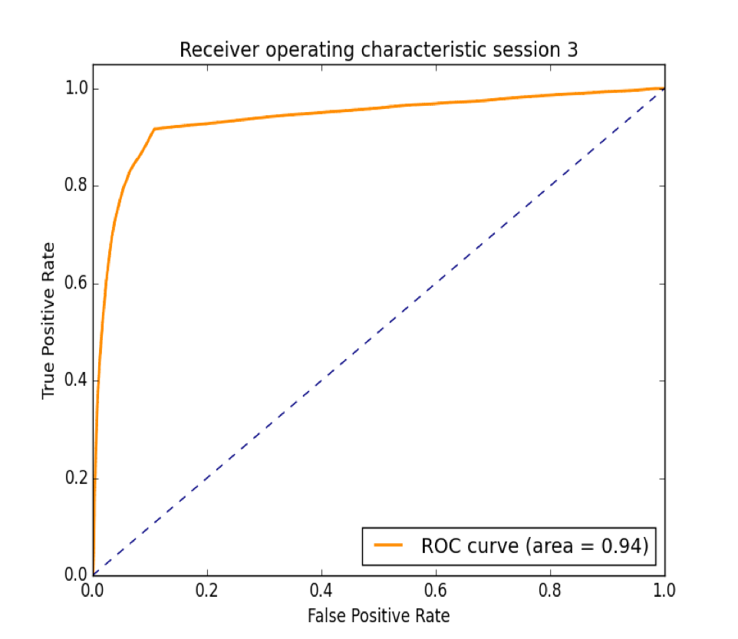
Results: Discussions Dataset

Slide 19
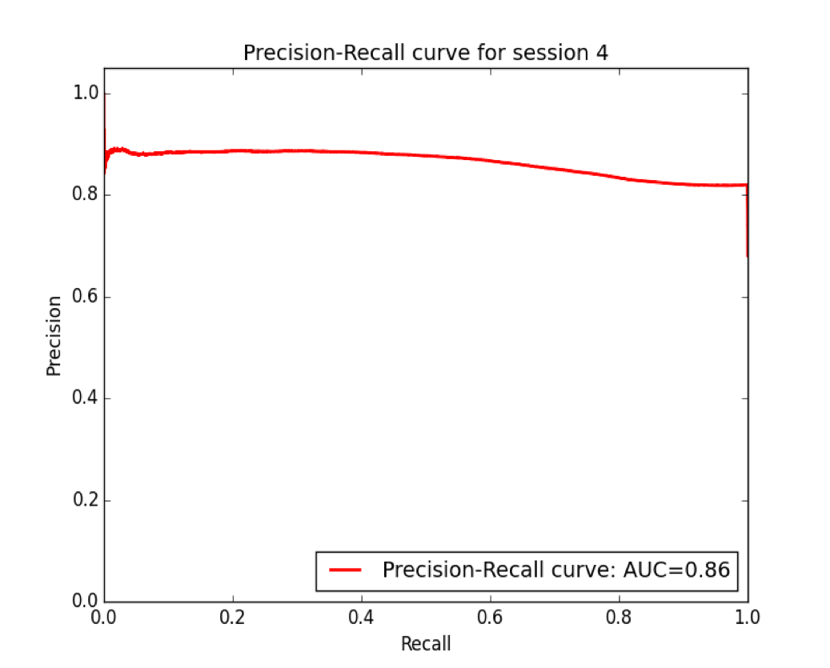
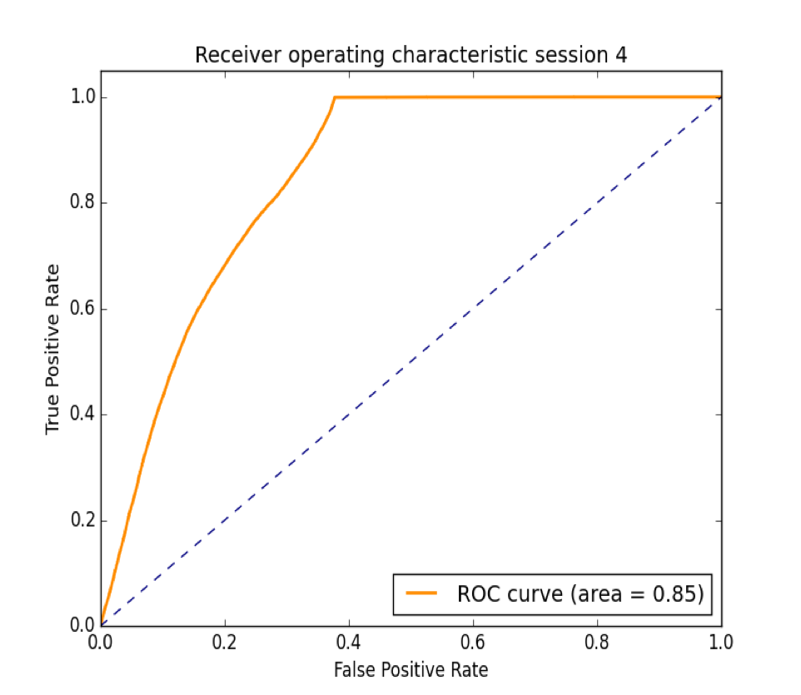
Results: Discussions Dataset

Slide 20
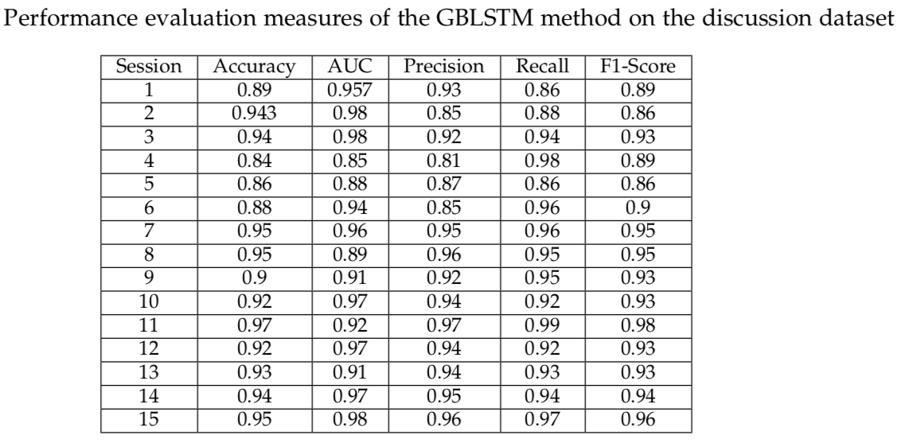
Results: Discussions Dataset

Slide 21
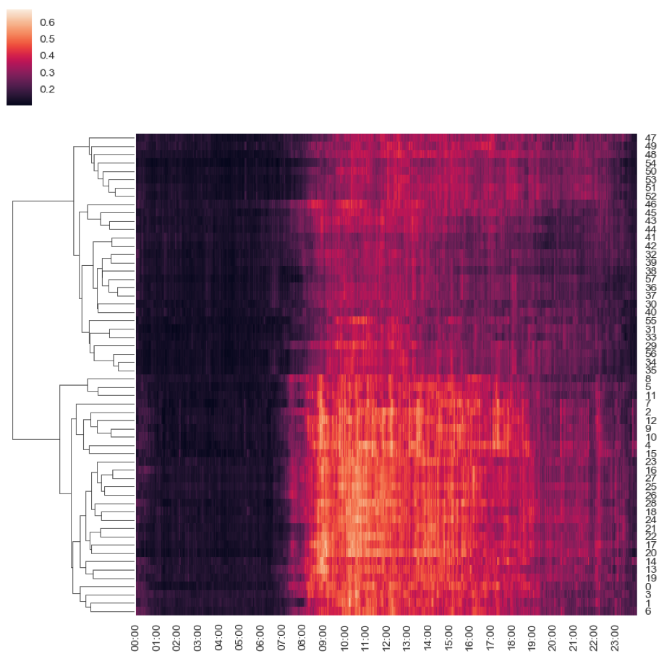
Results: Depression Dataset
Depressed Cohort
Control Subjects

Slide 22
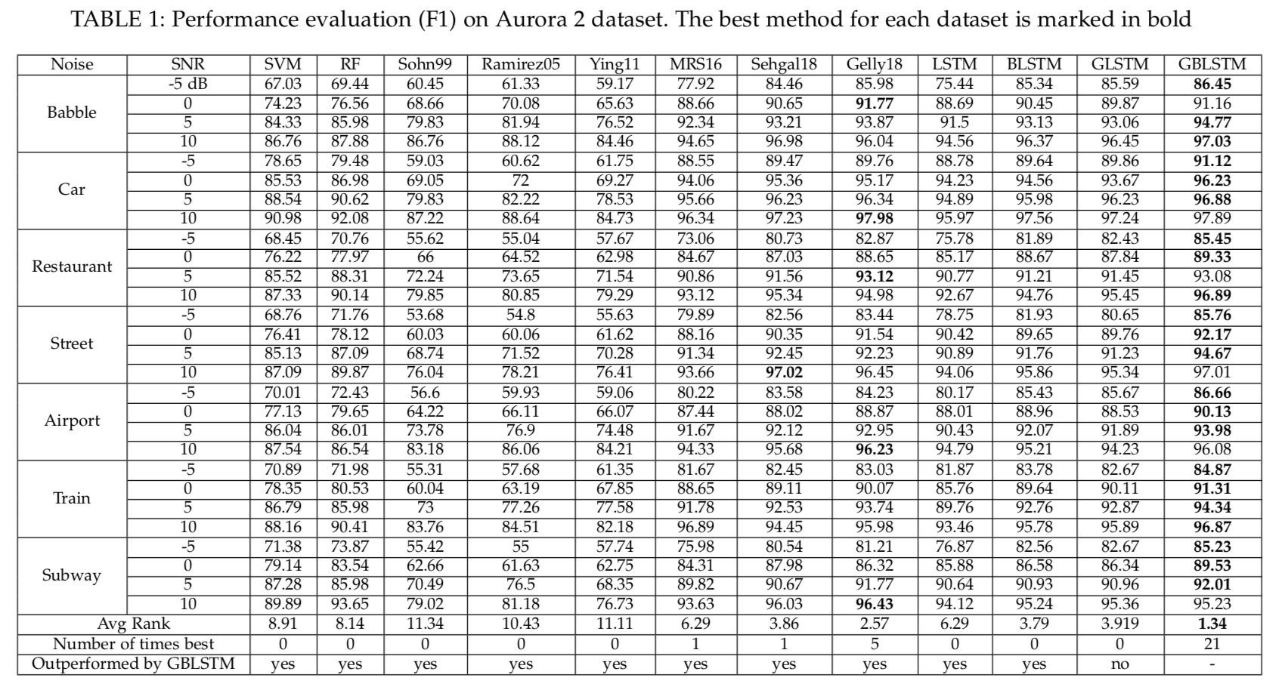
Results: Public Datasets

Slide 23
NatWearer: Network Architecture
Input data (256 dims)
Normalization
CNN Encoder: 2 conv1D layers, 2 subsampling layer, 1 Dense layer
4
CNN AE
CNN Encoder: 2 conv1D layers, 2 subsampling layer, 1 Dense layer
4 layers Bi-LSTM (TANH)
Dropout + gradient norm
ADAM,
LR: 1e-4
6 layers LSTM (TANH)
Dropout + L2 regularization
3 Maxout layers
Dropout
RMSPROP,
LR: 1e-4
1 Dense layer (leaky RELU)
Batch norm
Softmax layer

Slide 24
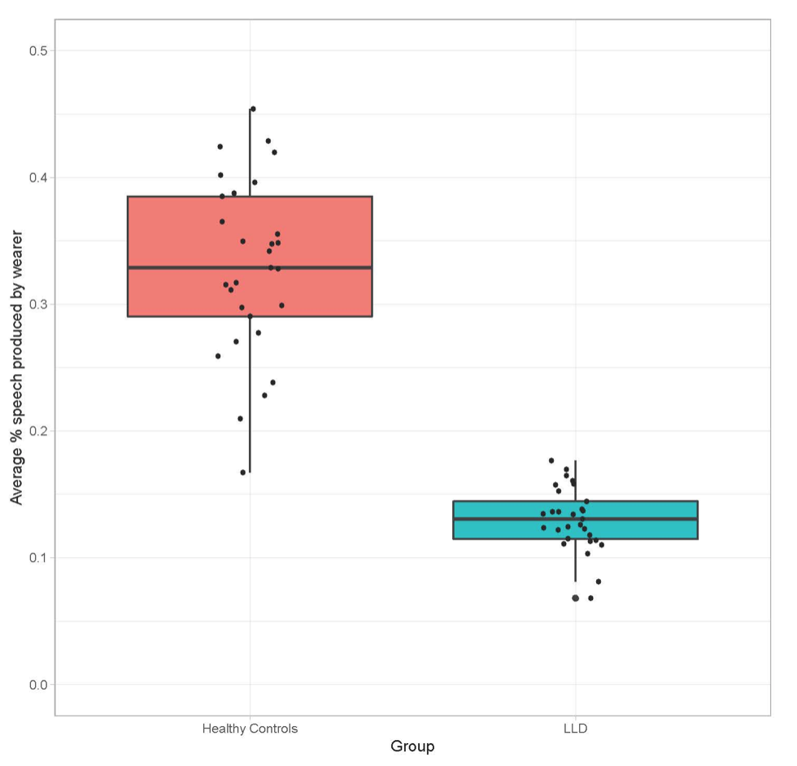
Results: Depression Dataset

Slide 25
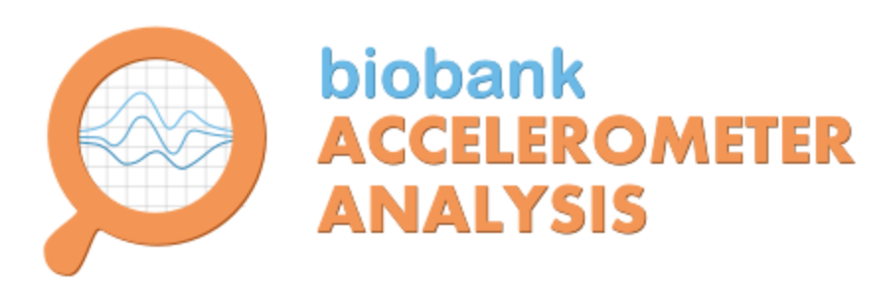
Movement Patterns Analysis

Slide 26
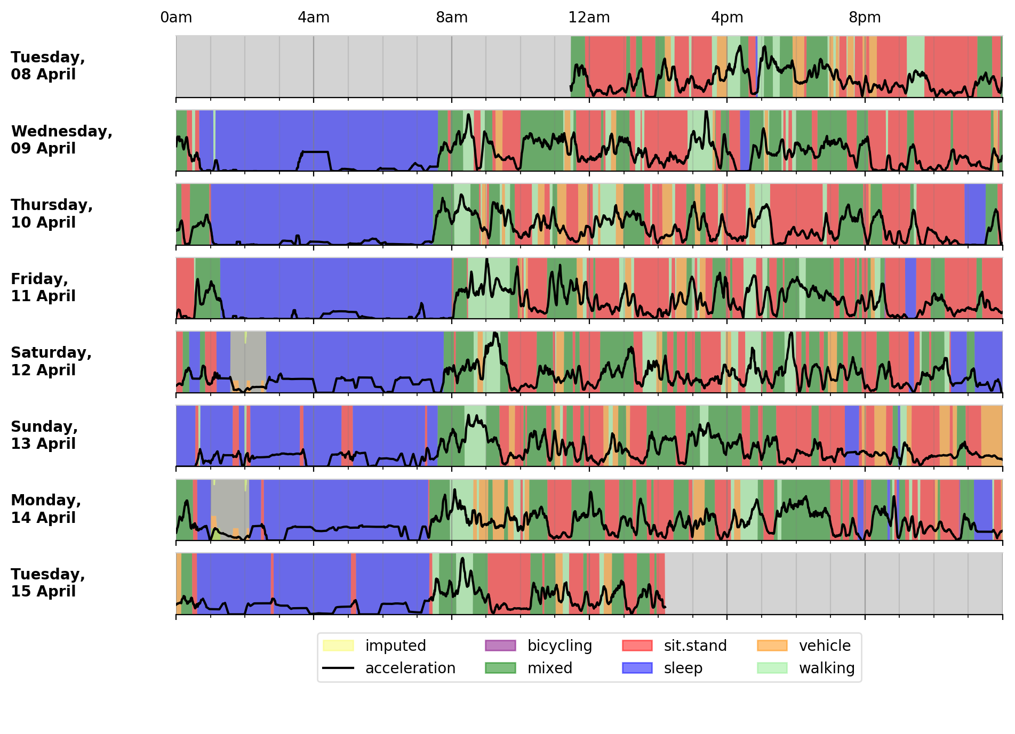
Movement Patterns Analysis

Slide 27
Conclusion
Verbal interactions Analysis:
Speech detection
Wearer detection
Movement Pattern Analysis
Oxford Analysis Tool
High level features for each activity between the group and looking over the variability.
Correlation with Clinical measures
Future steps:
Correlation between Speech and amount of each activity.

Slide 28



